Slide 1
ECE 4300 Project: Object Detection
Group B:
Ryan Agatep, Jose Hernandez, Daniel Pedro, Gloria Tovar

Slide 2
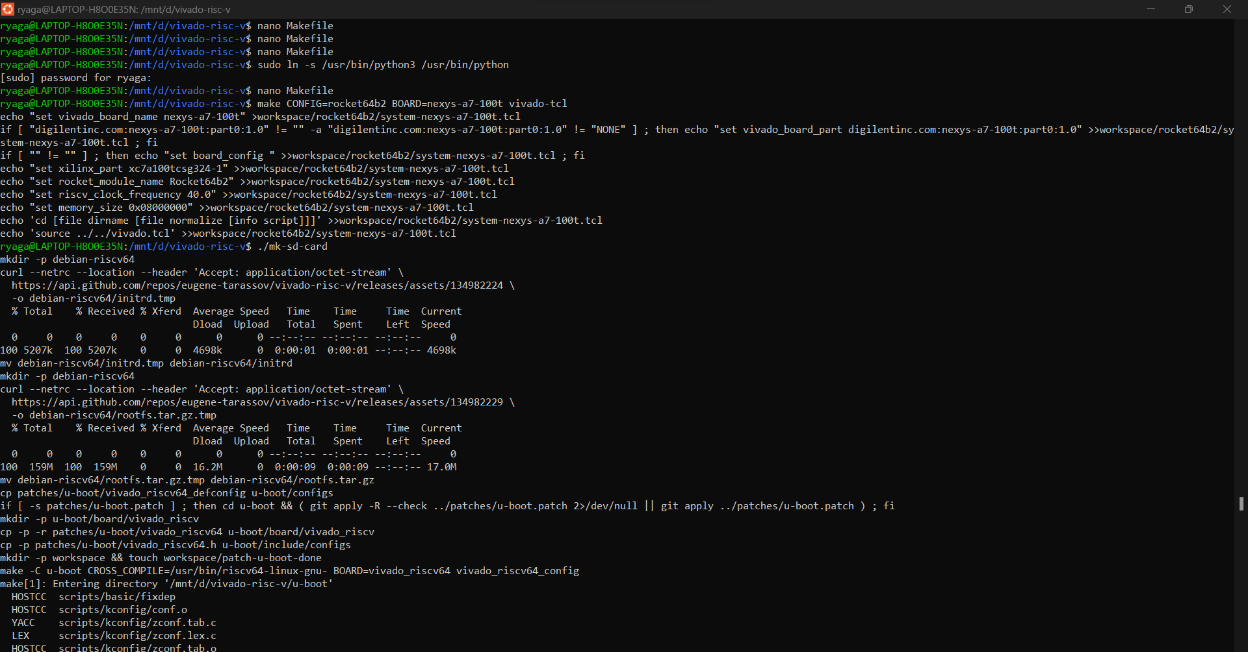
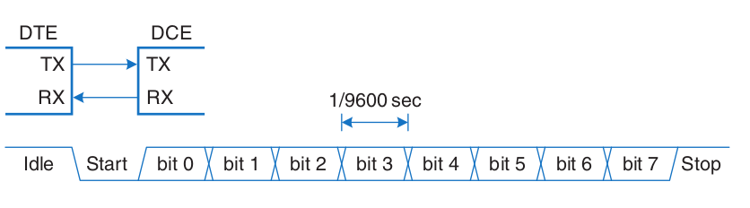
Vivado RISC-V
Loading RISC-V architecture onto Digilent Nexys A7 100t hardware
Communication had to be through serial connections: UART
Tried in Ubuntu 22.04 on VM and WSL2
Software used was AMD/Xilinx Vitis, which includes Vivado
Had to install OS image onto SD, then boot in Vivado

Slide 3
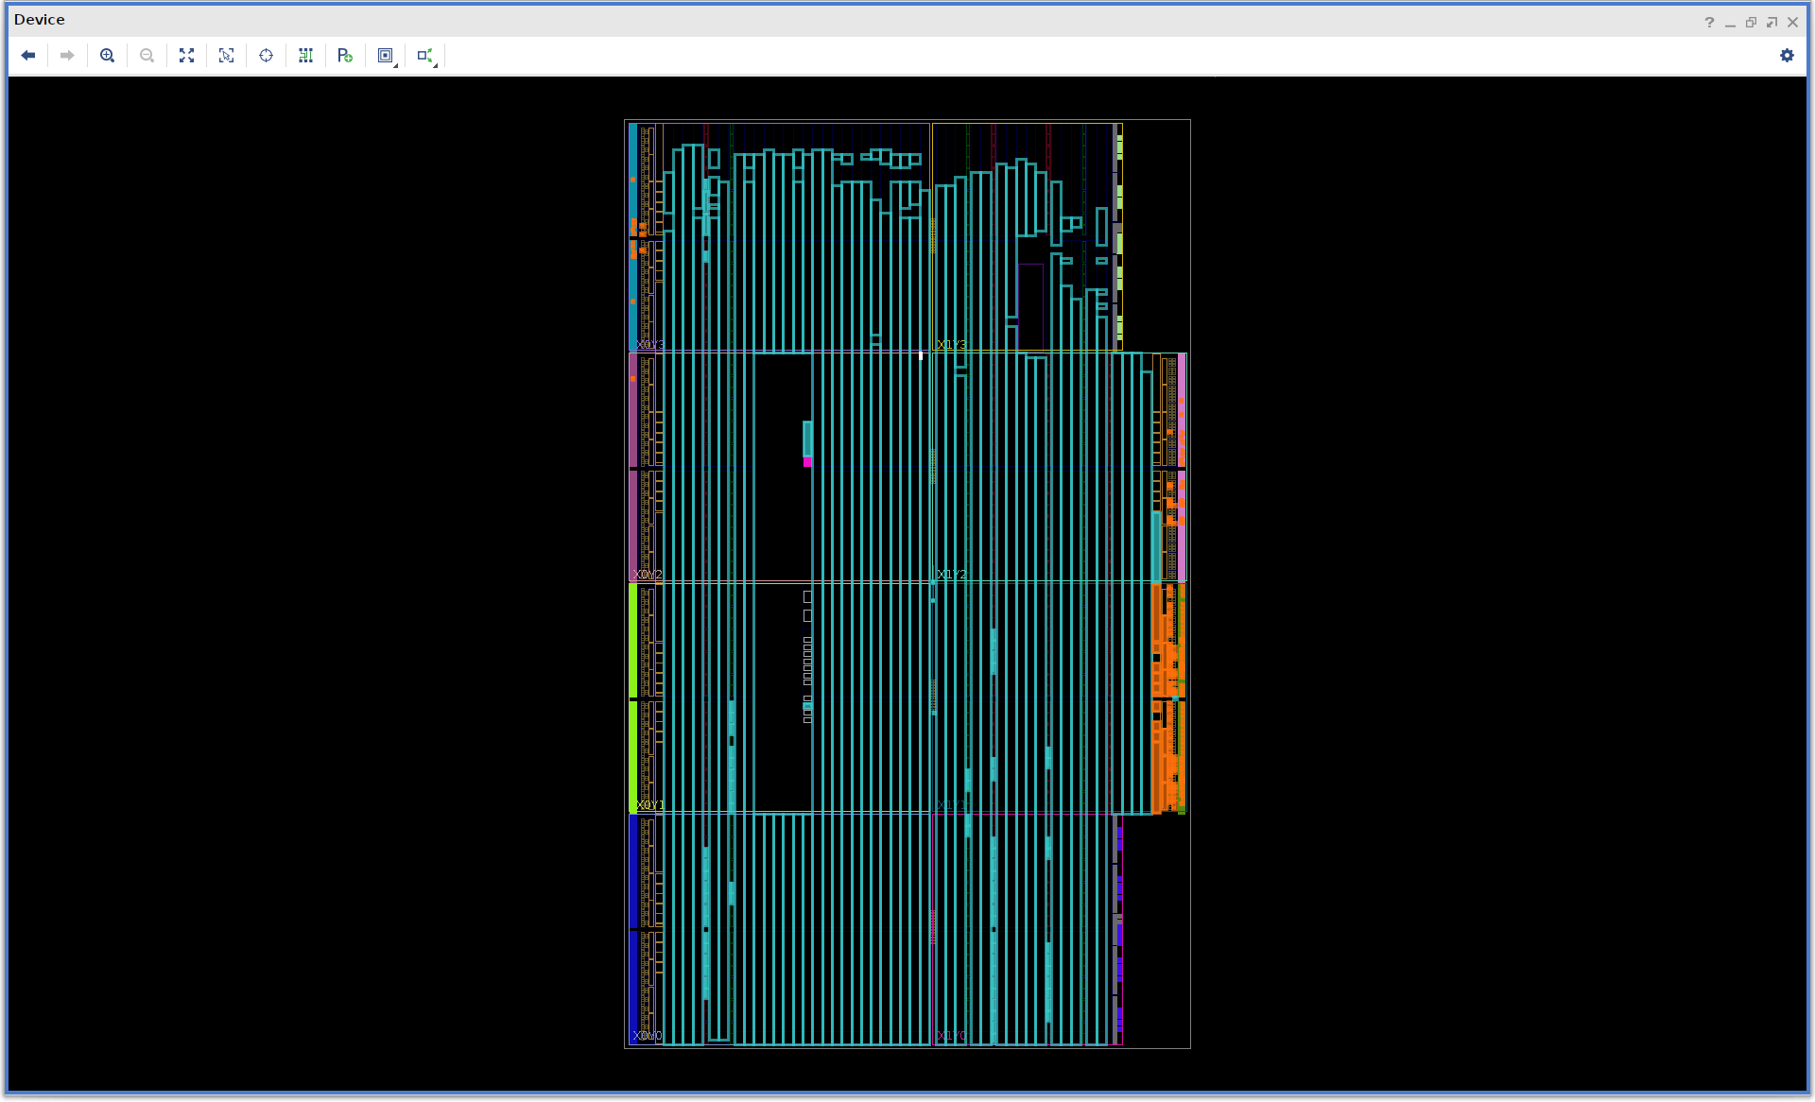

Slide 4
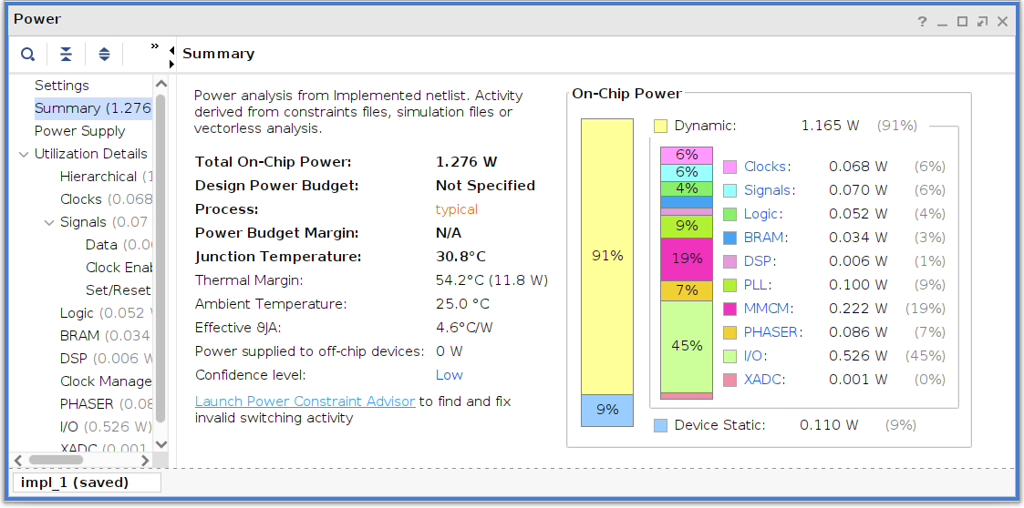

Slide 5
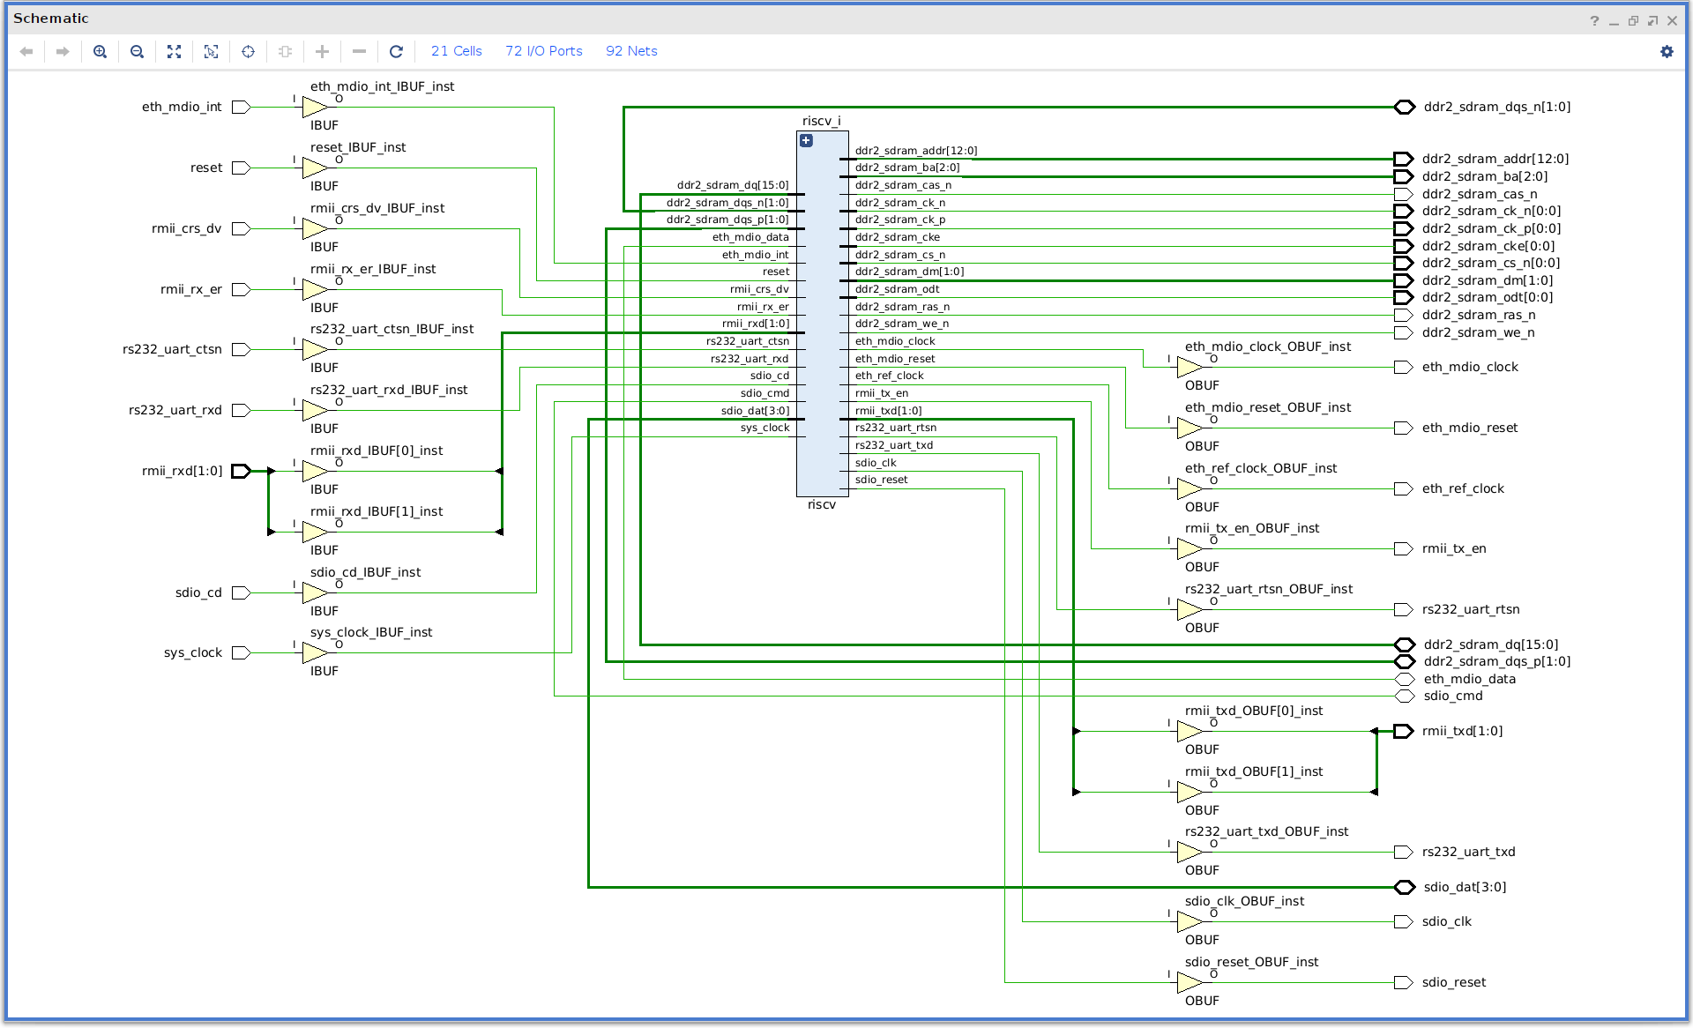

Slide 6
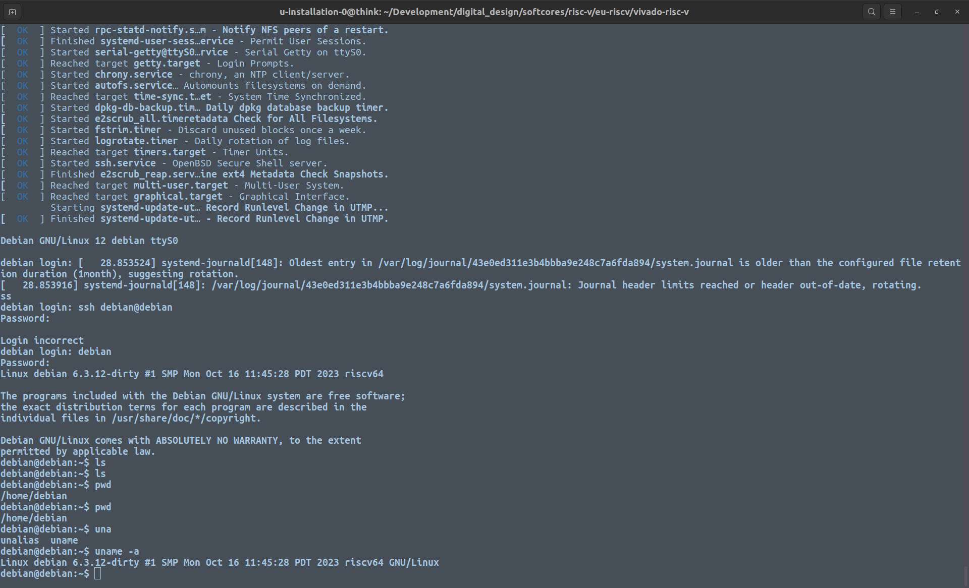
Emulation (Qemu)
RISC-V was emulated (same image as the one loaded onto FPGA)
Worked, but limited resources (storage, data)
Had to install GCC, basic OS toolchains

Slide 7
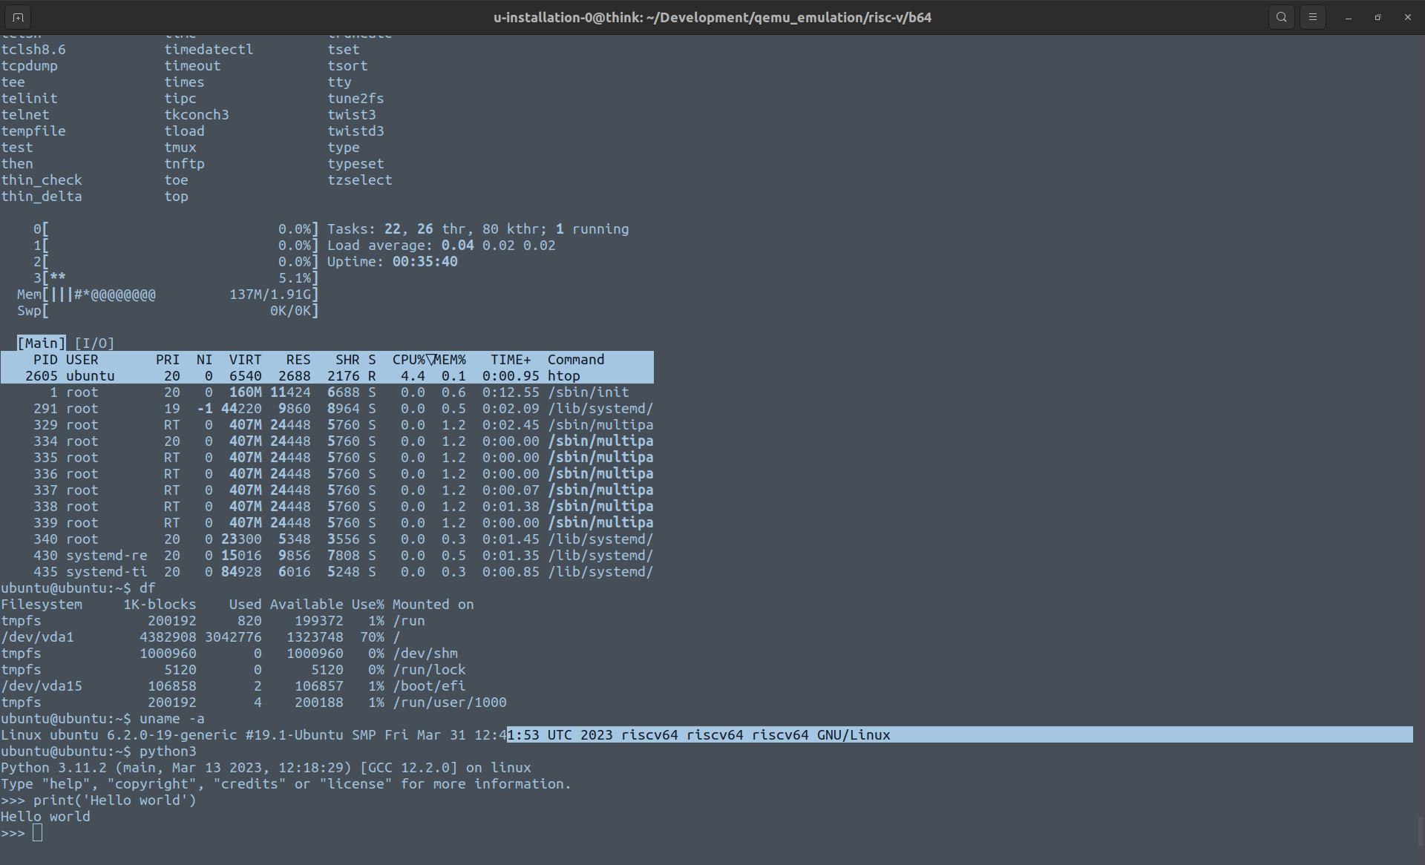

Slide 8
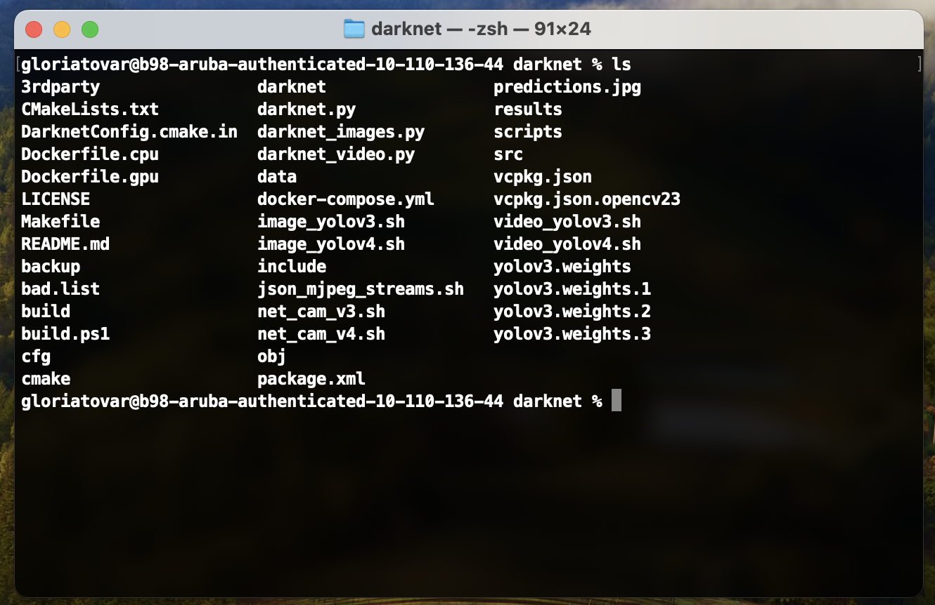
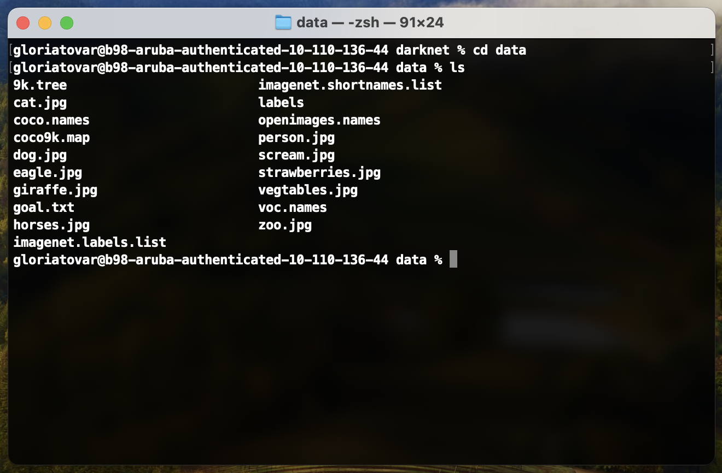
YOLO
Specifically used YOLOv3
Darknet
Open source neural network framework written in C
Helps to support CPU and GPU computation
What’s in the Darknet folder?
Prediction.jpg to include the results YOLO has provided
Data folder includes all images that were uploaded
Yolo weights
First tried on Mac Terminal
Then tried on Ubuntu 23.10.01

Slide 9
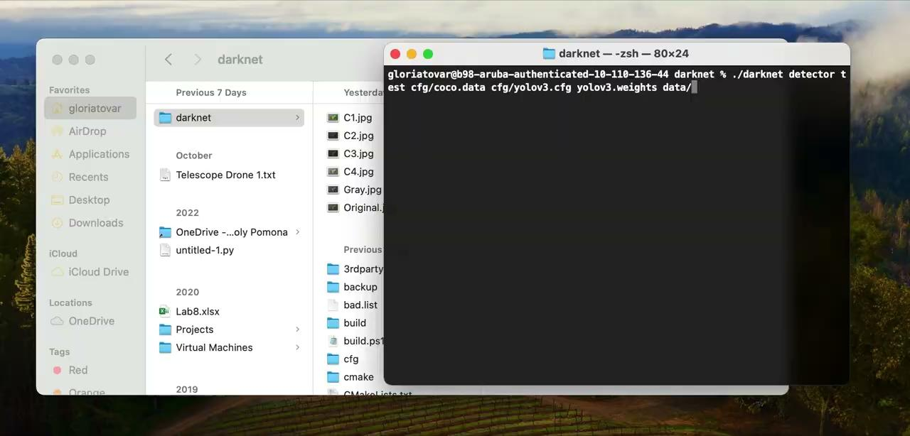

MAC Demo

Slide 10
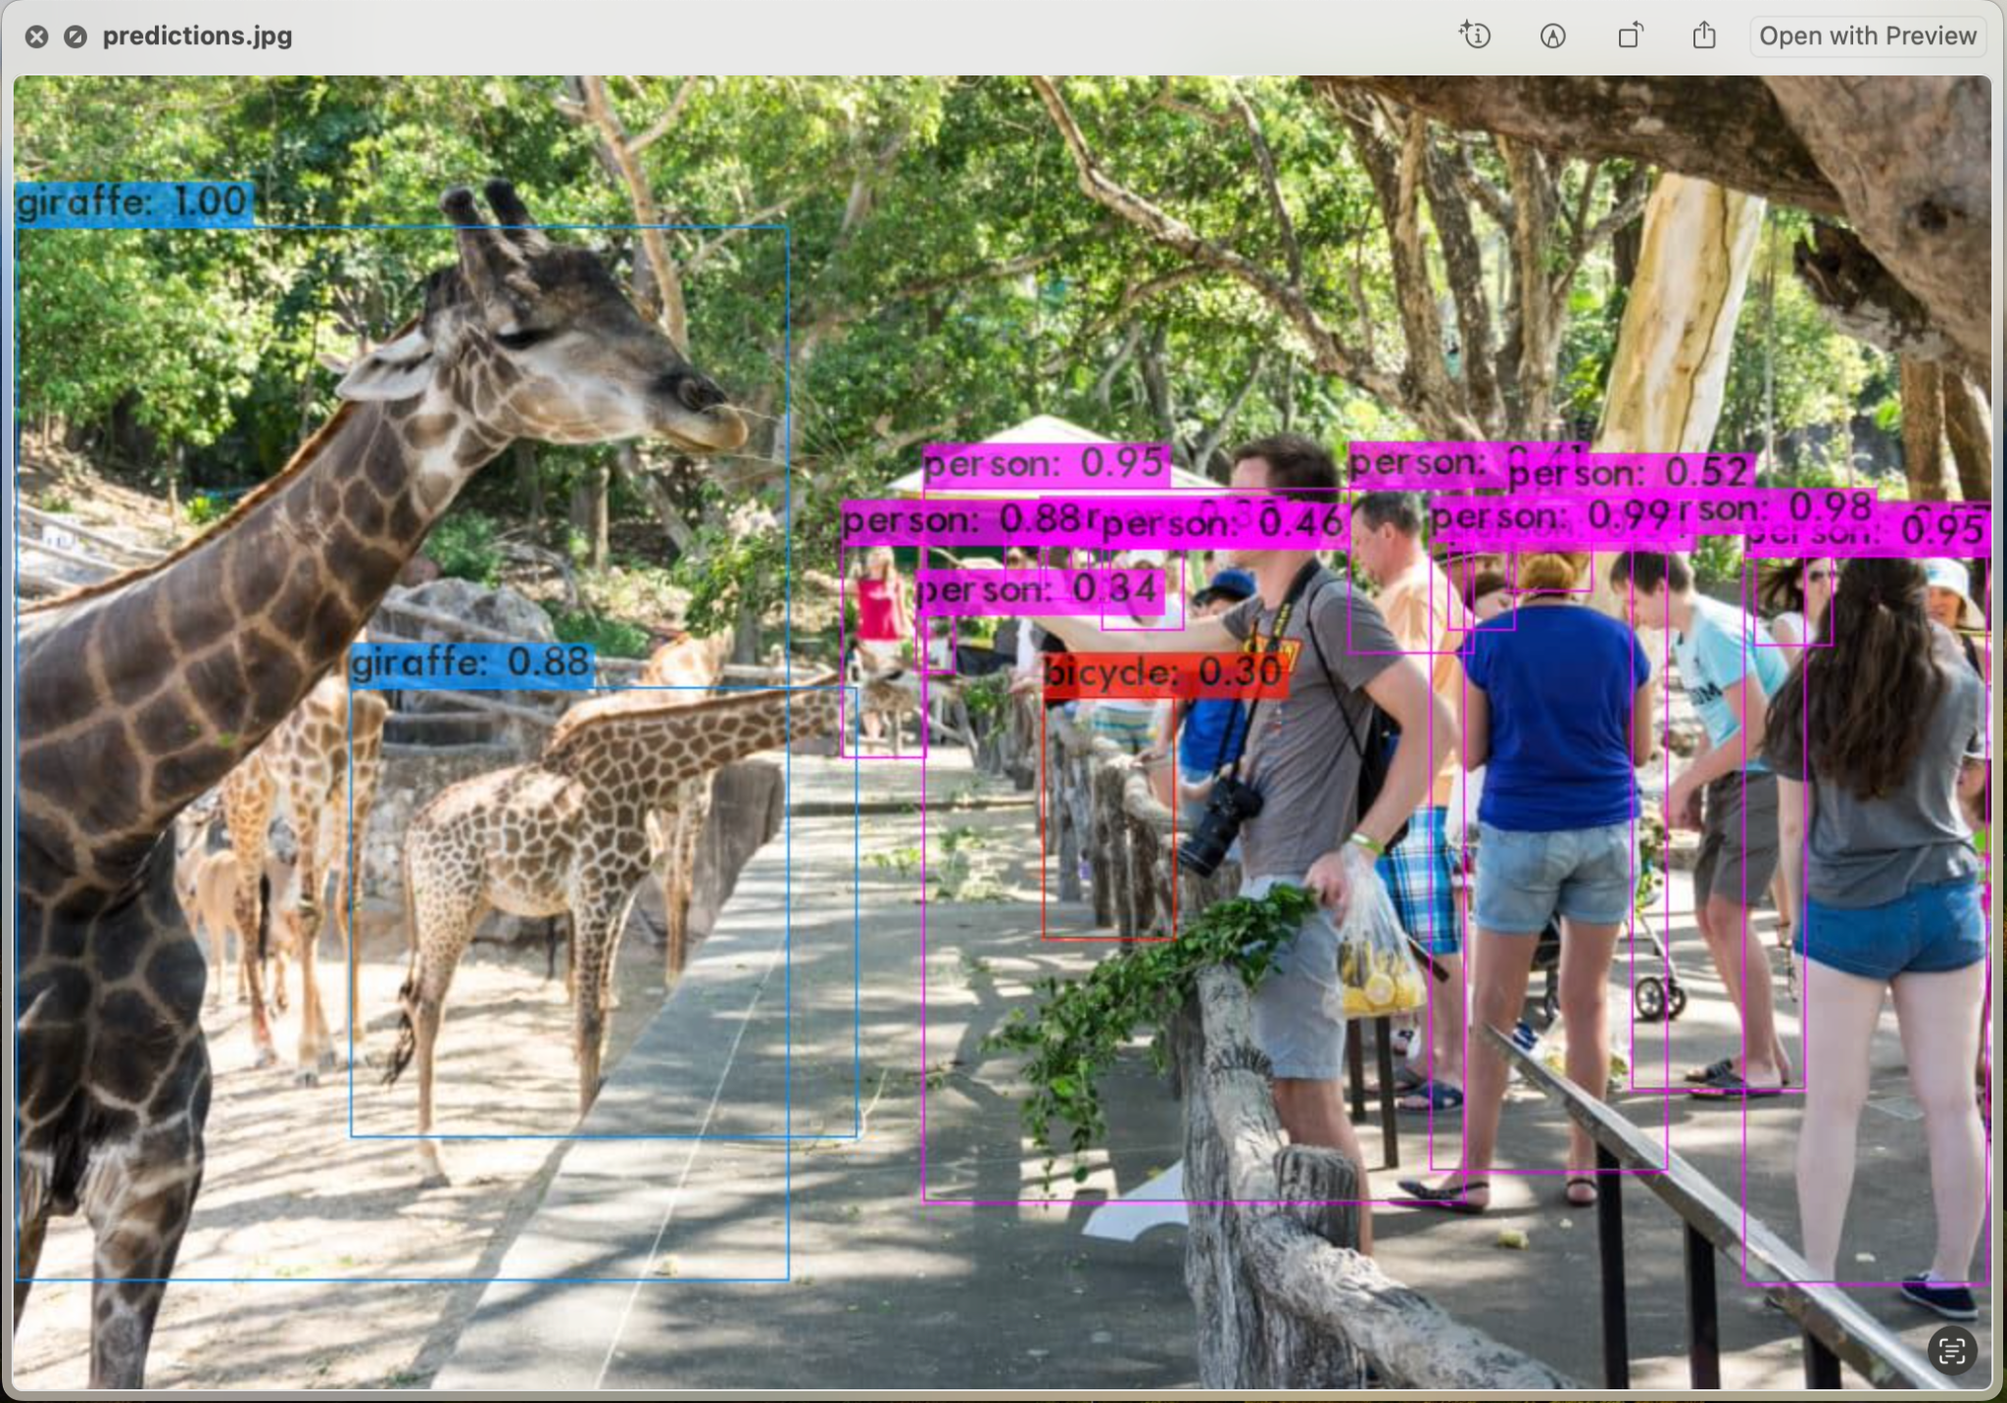
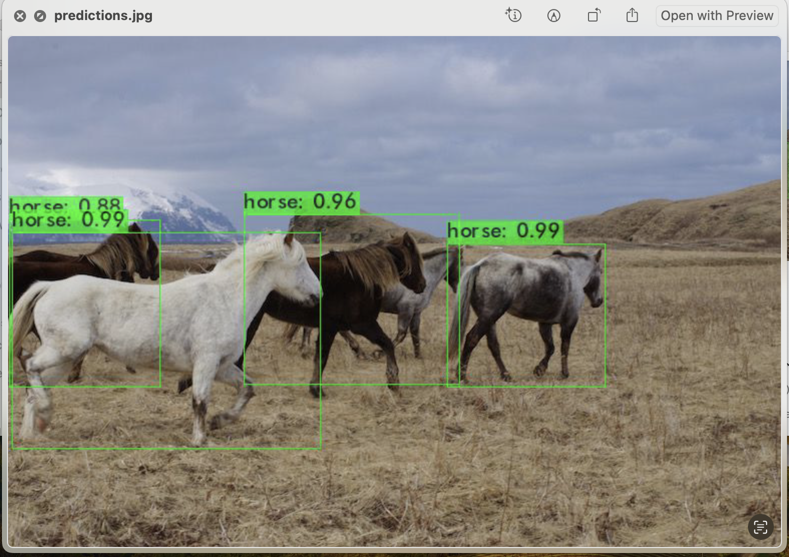
YOLO Results in MAC

Slide 11
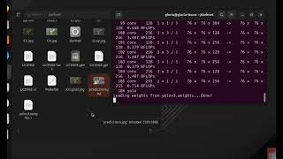
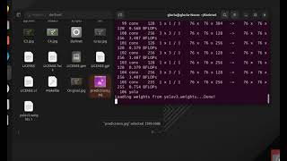
Ubuntu Demo in Mac Computer

Slide 12
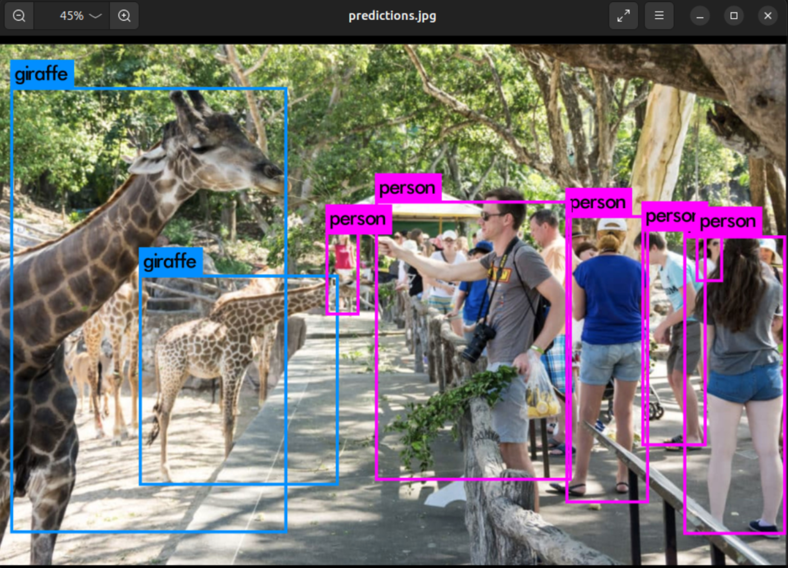
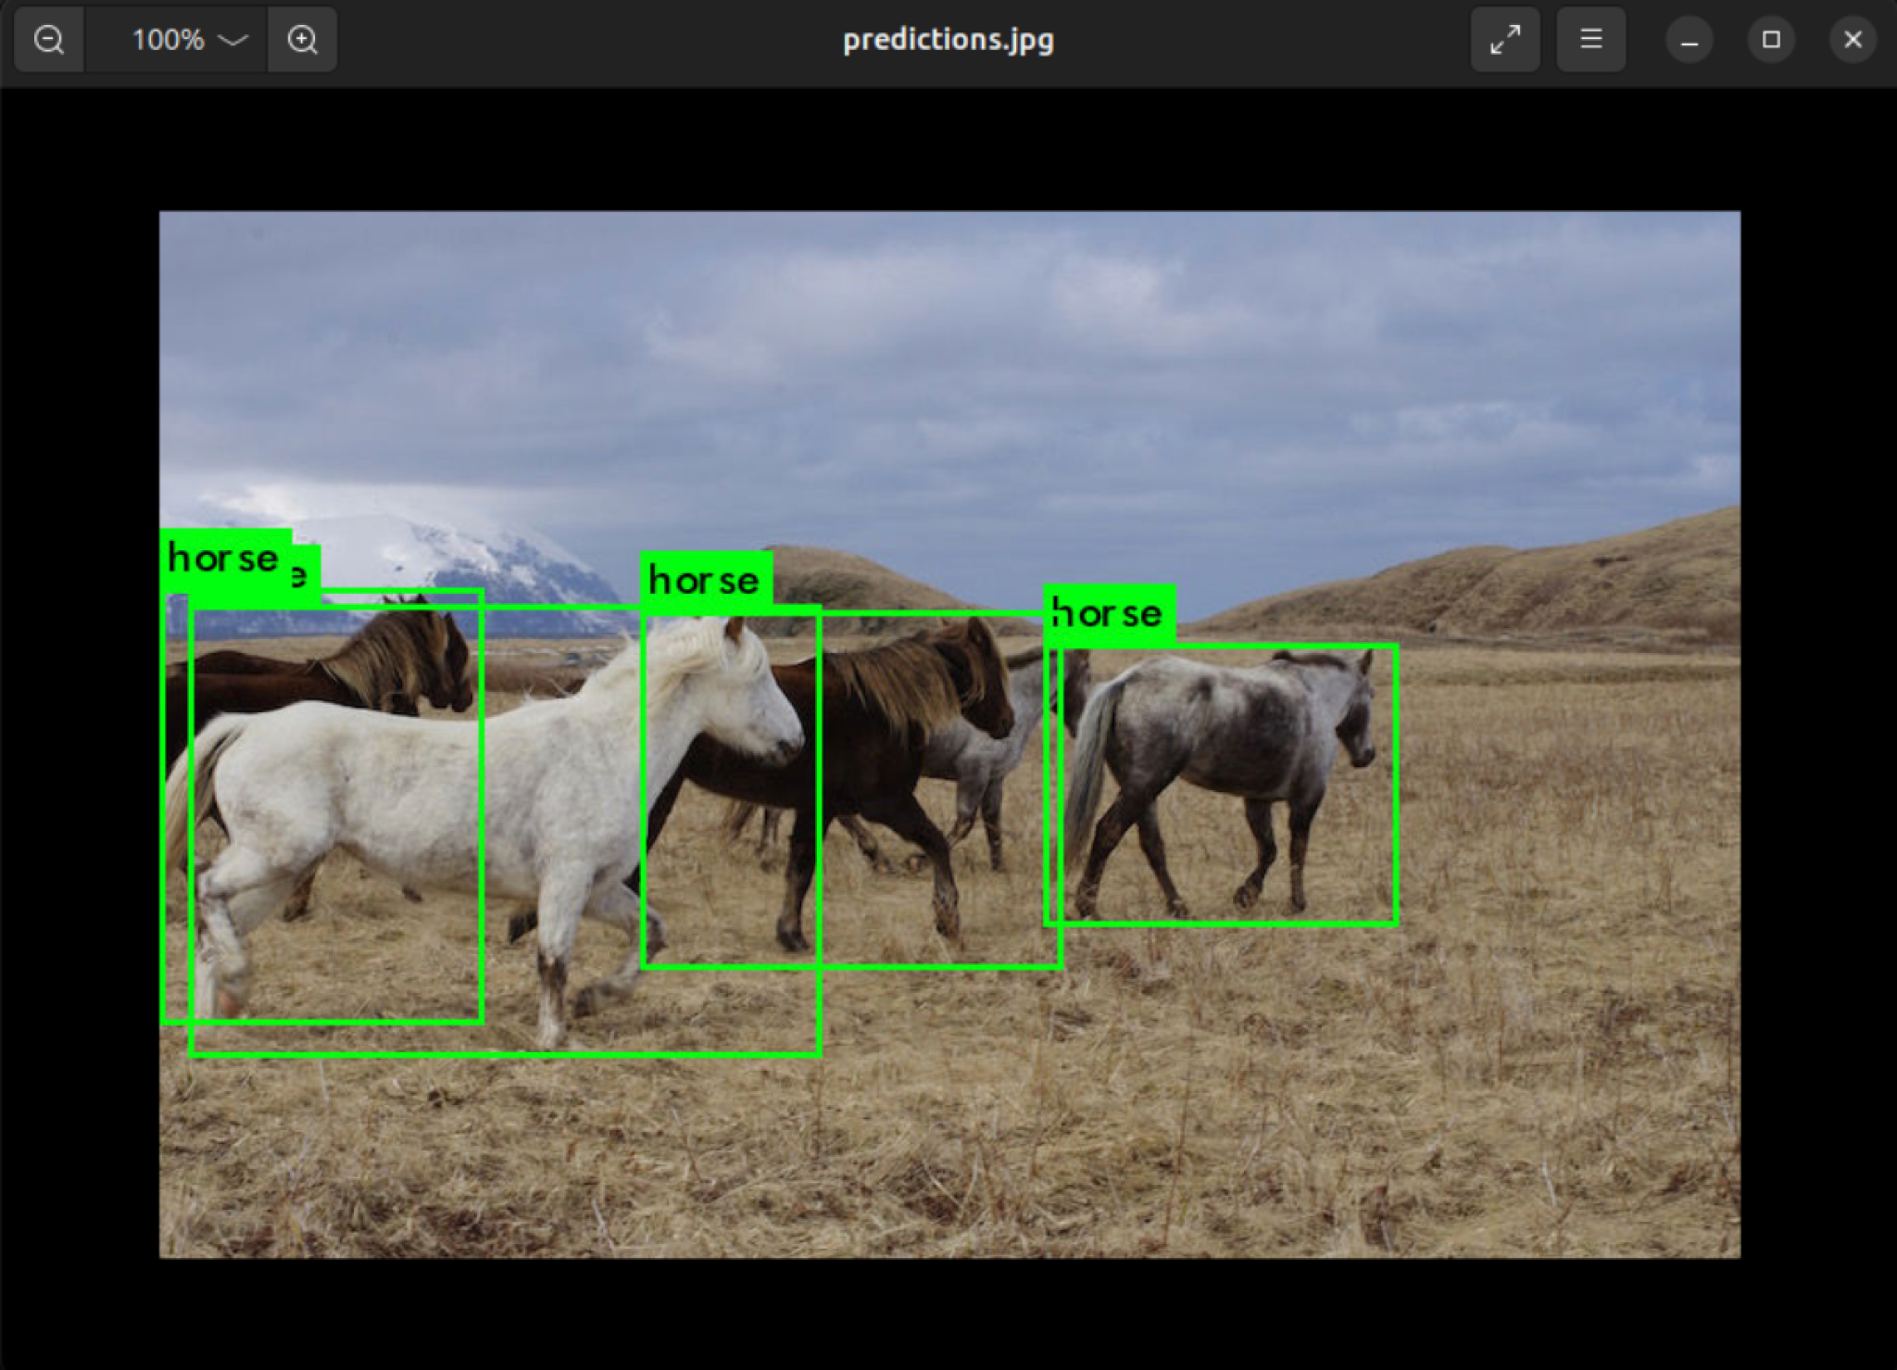
YOLO Results in Ubuntu

Slide 13
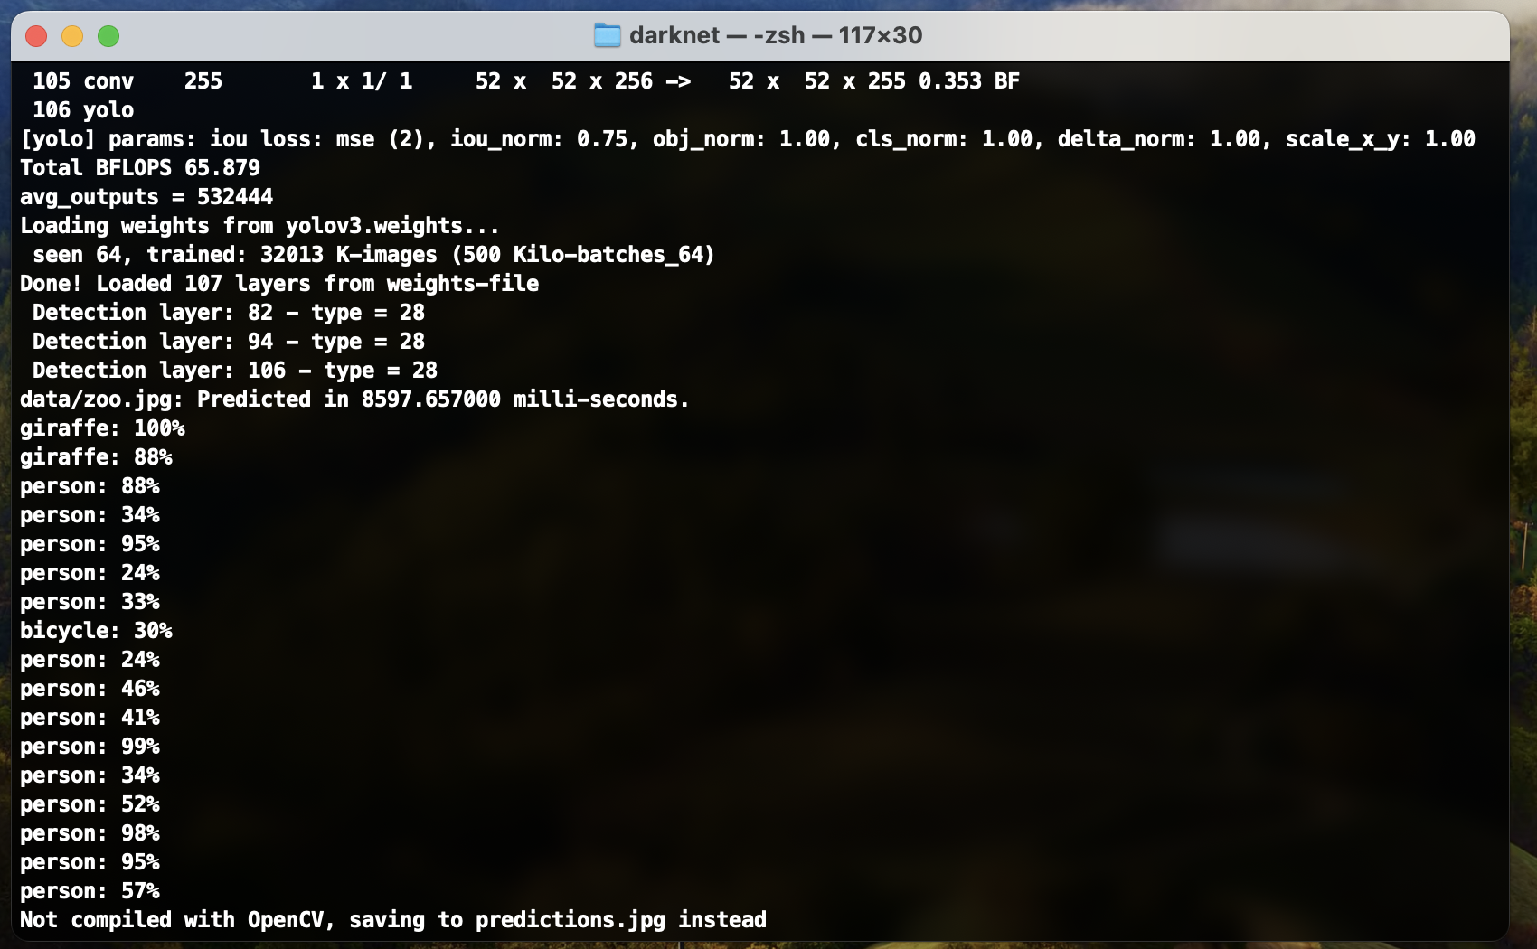
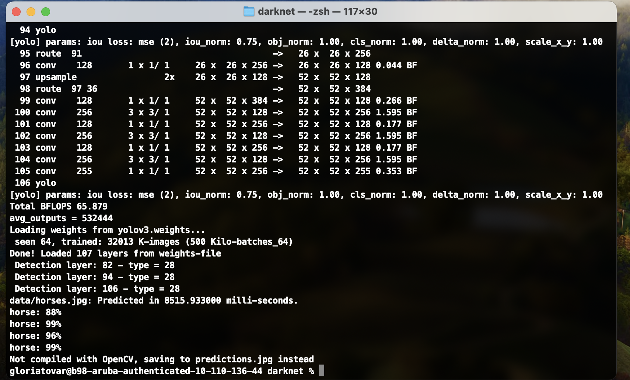
Performance (Execution Time) on MAC:
Execution Time on Mac
To get results, ran ./darknet detect cfg/yolov3-tiny.cfg yolov3-tiny.weights data/insert the name of jpg
For zoo.jpg,
It took around 8597.657 ms
For horses.jpg
It took around 8515.933 ms

Slide 14
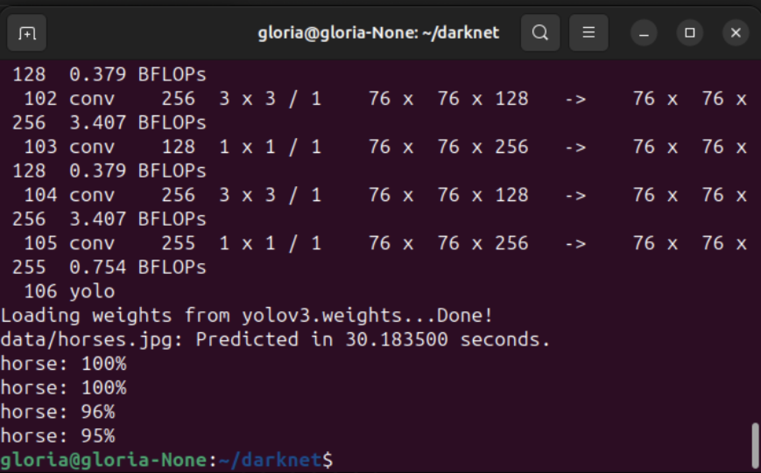
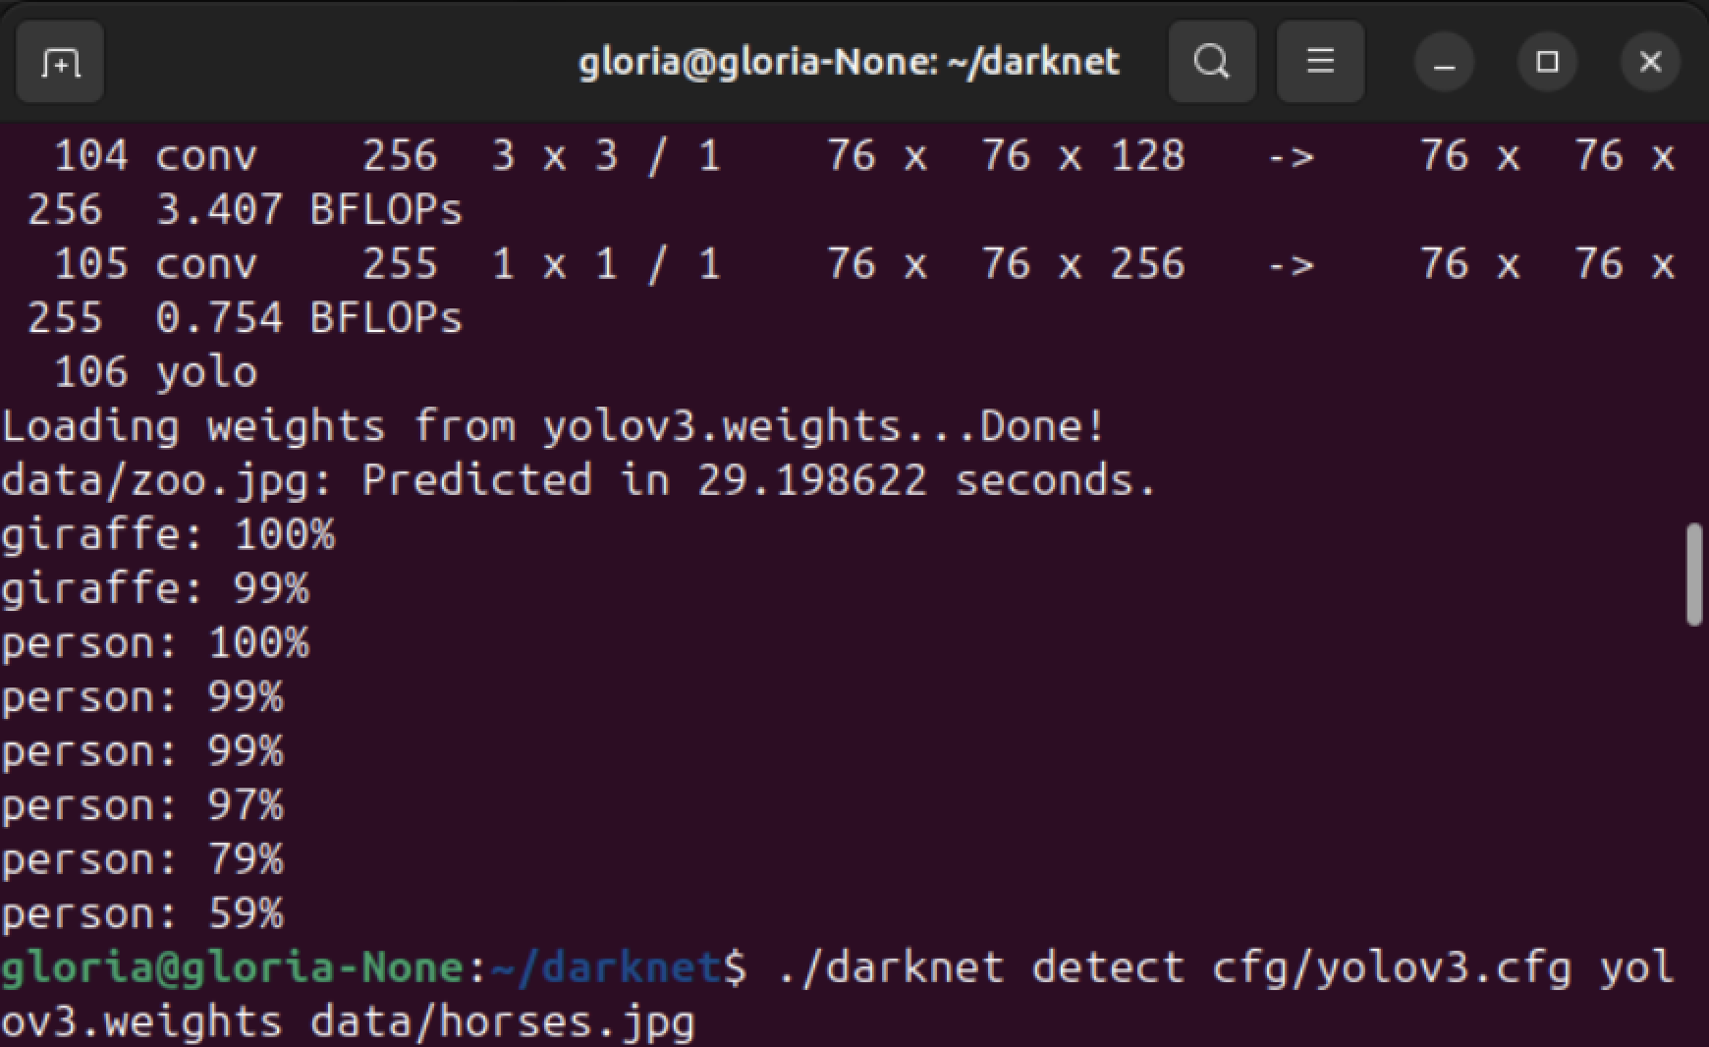
Performance (Execution Time) on Ubuntu:
Running Time on Ubuntu
To get results, ran ./darknet detect cfg/yolov3-tiny.cfg yolov3-tiny.weights data/insert the name of jpg
For zoo.jpg,
It took around 29.19 seconds
For horses.jpg
It took around 30.18 seconds

Slide 15
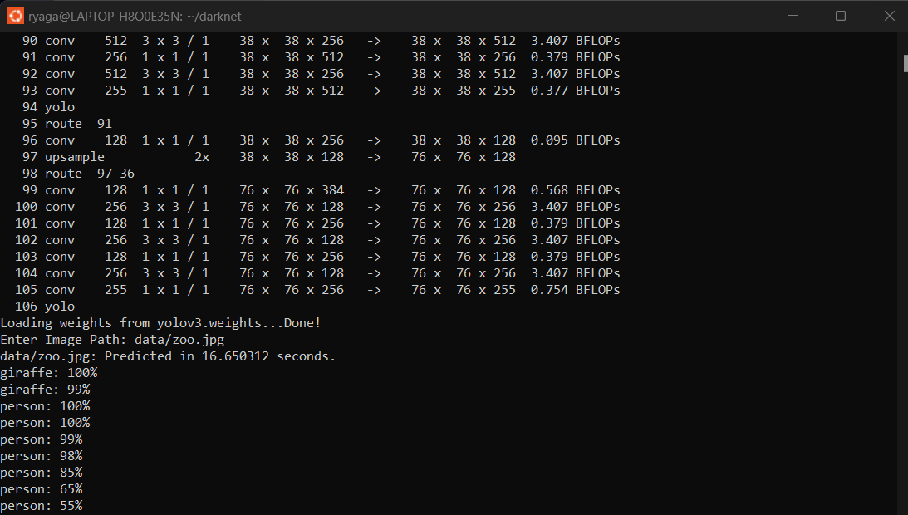
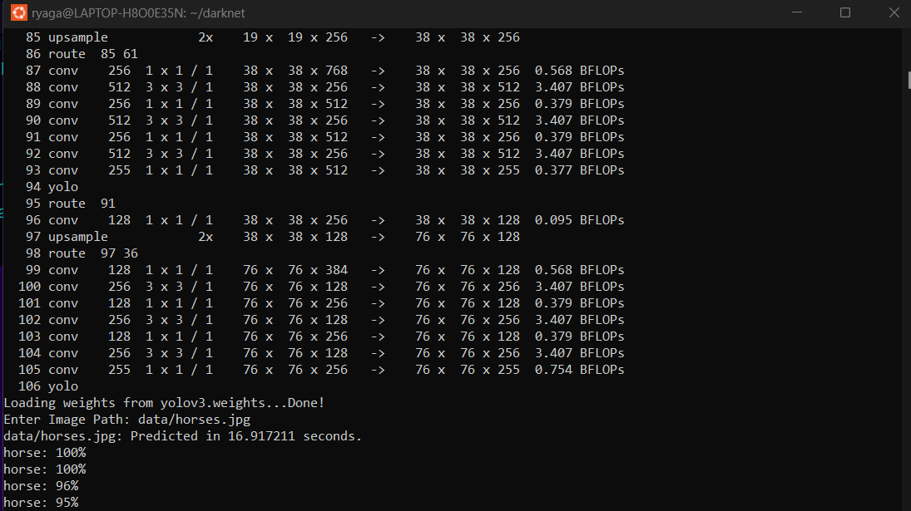
Performance (Execution Time) on Windows Ubuntu WSL2:
From the previous slides on the images (on Windows),
To get results, ran ./darknet detect cfg/yolov3-tiny.cfg yolov3-tiny.weights data/insert the name of jpg
For zoo.jpg,
It took 16.650312 s
For horses.jpg
It took 16.917211 s

Slide 16
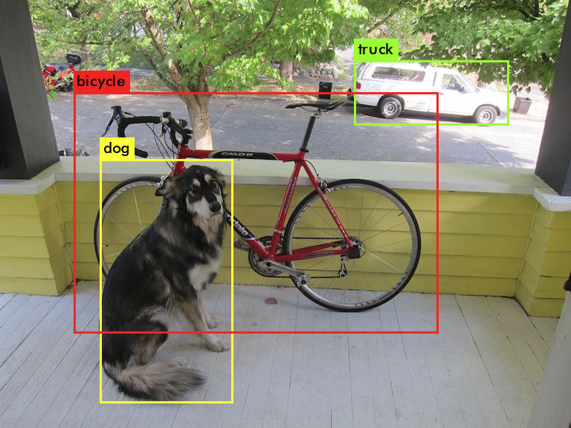
Performance Execution Time (x86):
12th Gen Intel(R) Core(™) i7-12800HX
Ran “./darknet detect cfg/yolov3.cfg yolov3.weights data/dog.jpg” several times
Average: 11.905seconds
Median: ~11.86
Mode: N/A always <12s

Slide 17
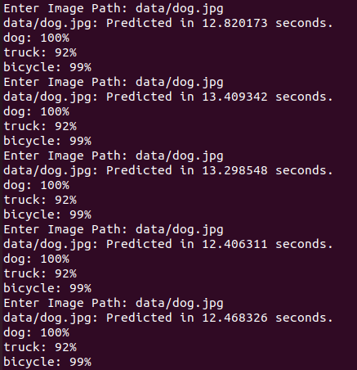
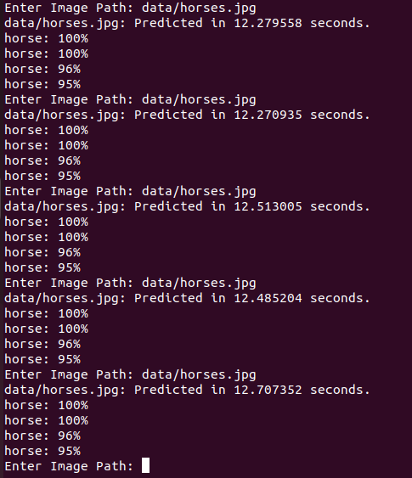
Performance Execution Time (x86) on V.M. running Ubuntu:
AMD Ryzen 9 5900HS
Ran “./darknet detect cfg/yolov3.cfg yolov3.weights data/dog.jpg” 5 times
Ran “./darknet detect cfg/yolov3.cfg yolov3.weights data/horses.jpg” 5 times
Average: 12.880 & 12.451 seconds

Slide 18
Thank you

